Slide 1
Section 2.4 Scientific Notations
© Copyright all rights reserved to Homework depot: www.BCMath.ca

Slide 2
Review: Powers of 10
10 to the power of a whole number “n” will be equal to “1” followed by “n” zeroes
10 to the power of a negative integer “n” will be equal to “1” with “n” zeroes before it

Slide 3
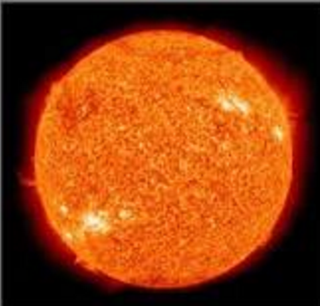
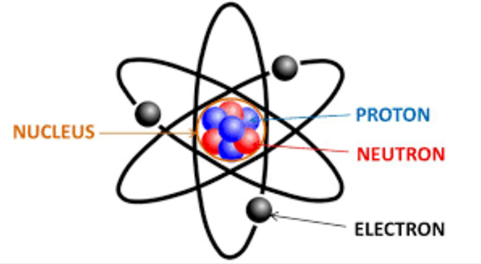
What are Scientific Notations?
Scientific Notations are used to represent both numbers that are either very large or very small
Example of Scientific Notations
Mass of an electron: 9.1 x 10⁻³¹ kg
Mass of the sun: 1.989 × 10^30 kg
Scientific notations are used without having to write too many zeroes
http://micro.magnet.fsu.edu/primer/java/scienceopticsu/powersof10/index.html

Slide 4
Ex: Write the following values in Scientific Notation

Slide 5
Write the following as a single scientific notation:

Slide 6
Now find half of 12 → 6
B
We can write this as a scientific notation
E

